Slide 1


Overview of the DCC
Joy Davidson
Digital Curation Centre

Slide 2
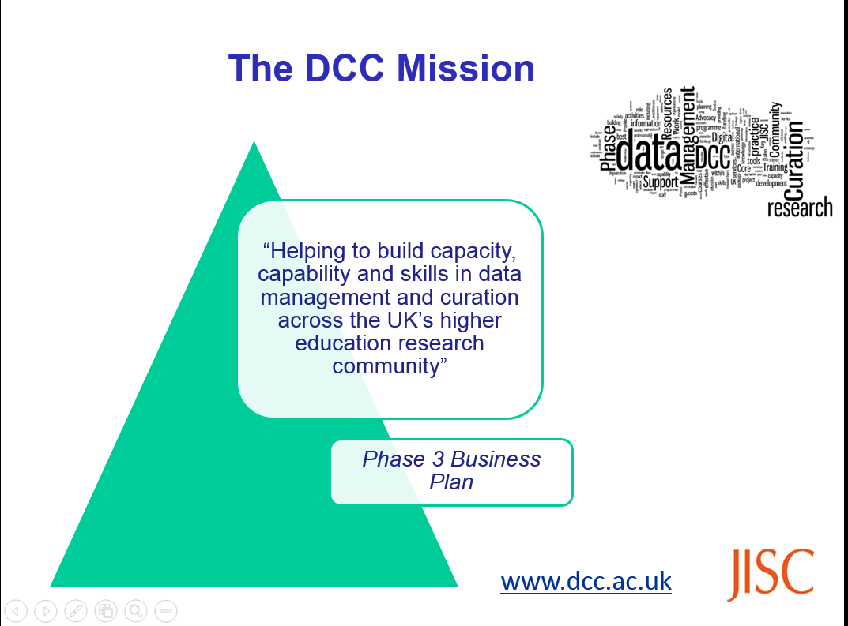
Digital Curation Centre (DCC)
Notes:
Currently funded by Jisc and European Commission activity, the DCC has been around for 12 years. DCC was originally funded jointly by Jisc and EPSRC under the eScience programme (2004-2007). Illustrates that EPSRC has been considering the challenges around research data management and longer term curation of research data for some time.
2

Slide 3
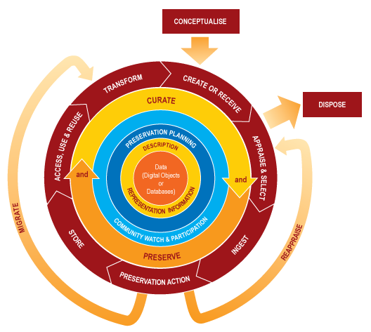
What is data curation?
Active and ongoing
Adding value
Many actors involved
Notes:
Data management and curation involves caring for, facilitating access to, preserving and adding value to digital research data throughout its lifecycle.

Slide 4
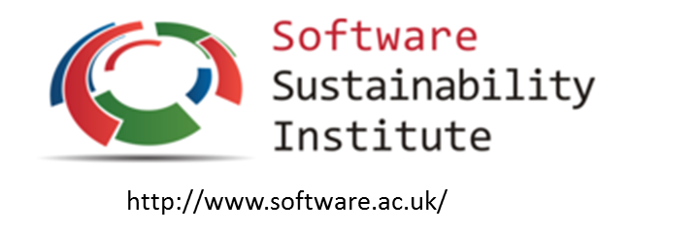
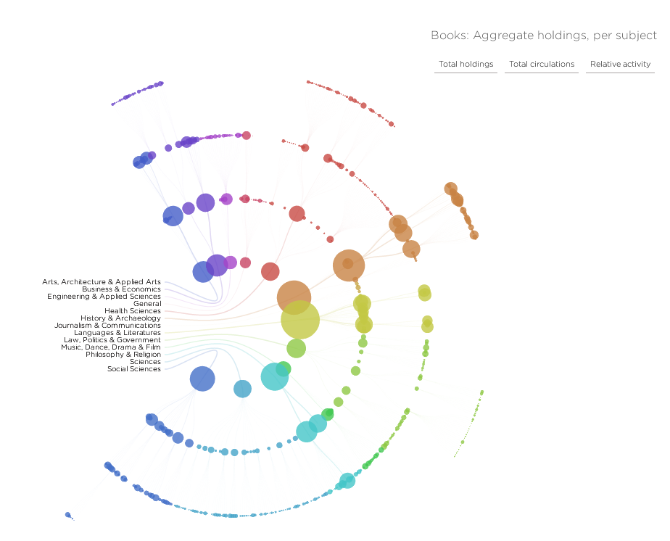

What do we mean by data?
Software, code and algorithms
Models and visualisations
http://spatialinformationdesignlab.org/project_sites/library/catalog.html
Open Access – publications and data
Notes:
Raw, cleaned, processed, derived,
Audio, visual, structured
Algorithms and software too!

Slide 5
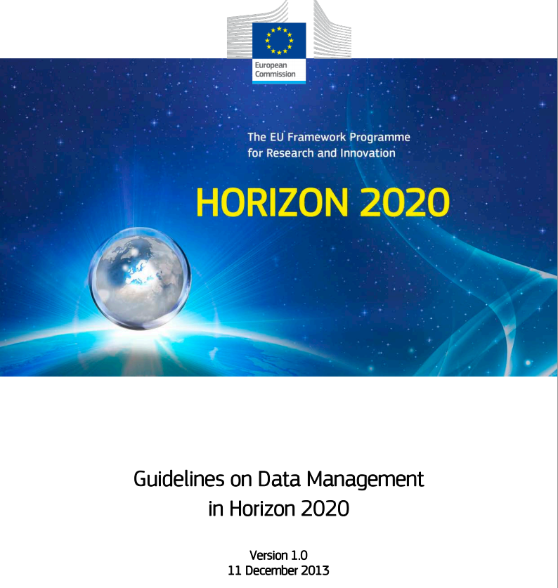


Yes, funders have expectations about data sharing…
Common Principles on Data Policy
http://www.rcuk.ac.uk/research/Pages/DataPolicy.aspx
http://ec.europa.eu/research/participants/data/ref/h2020/grants_manual/hi/oa_pilot/h2020-hi-oa-data-mgt_en.pdf
Notes:
Funding body mandates have been a key driver for improving RDM infrastructure and practice. RCUK issued its common principles on research data several years ago to address this need for transparency and value.
Funders have an obligation to show that public funds are being allocated appropriately. Important to note that funders need to demonstrate impact too. Otherwise research budgets shrink!
Not just UK, H2020 open data pilot and enthusiasm for Open science.
Important to stress that funders are NOT saying that ALL data must be kept or shared. Funders expects responsible research practice.
5

Slide 6

…but RDM is part of good research practice!
“Data sets are
becoming the new instruments of
science”
Dan Atkins, University of Michigan
Notes:
Data driven research is becoming the norm for all disciplines even arts and humanities. To be effective in this era, researchers need access to high quality data.
Currently, there are very worrying stats around the percentage of published findings that are reproducible.
6

Slide 7
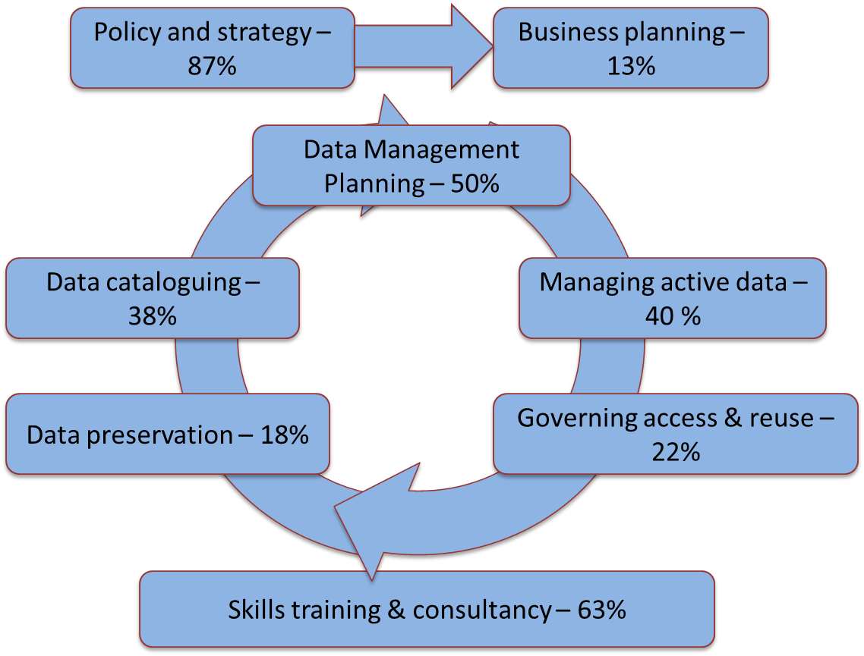
What is the national picture in the UK?
% indicating ‘rolling out’ or ‘embedding’
Notes:
The 2015 DCC survey collected responses from 60 institutions mapped to the DCC RDM services model.
You’ll notice that training, policy and business planning underpin the more technical infrastructure requirements in the centre which as based around the data lifecycle.
Majority of UK HEIs making good progress in developing policy, data management planning and training and guidance. Longer term preservation and business case development are proving more difficult across UK HEIs. These challenges could have an impact on other aspects of RDM service provision as well.
7

Slide 8
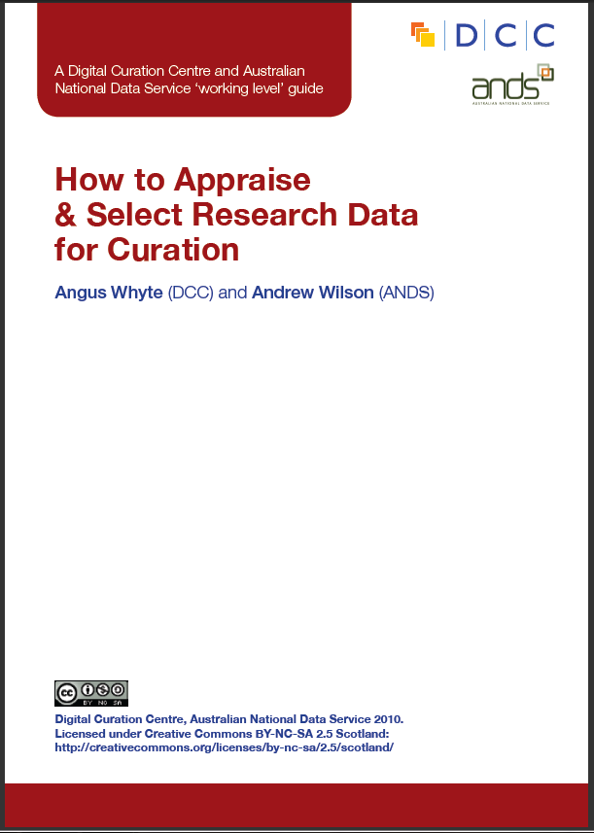
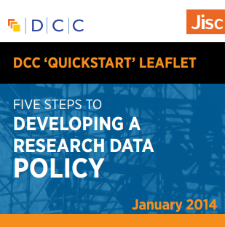
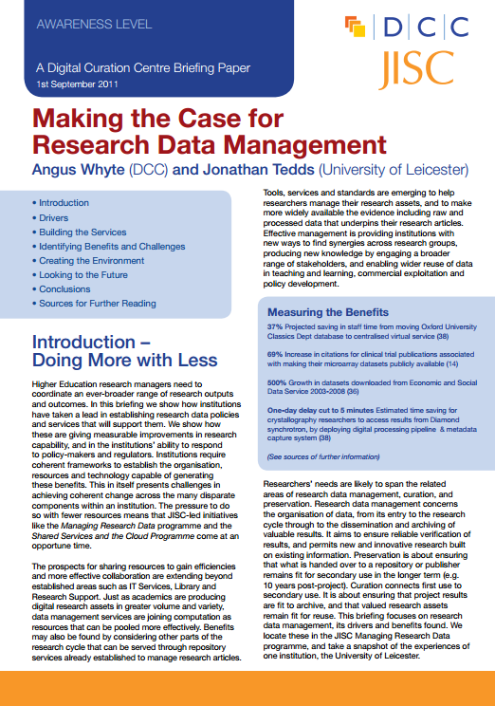
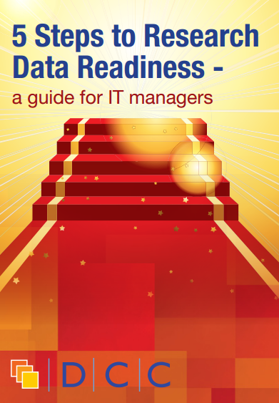
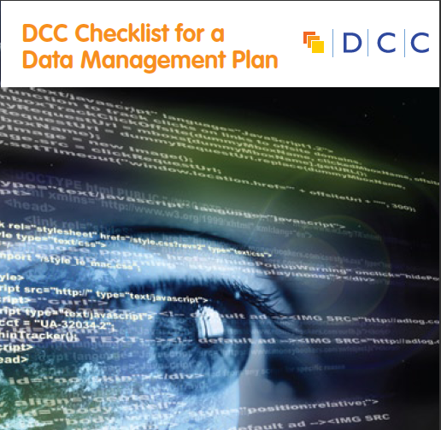
DCC provides access to learning resources
www.dcc.ac.uk/resources/
Notes:
DCC provides free access to a number of short, practical guides on various topics:
-How to discover RDM requirements
-How to develop RDM services
-How to develop a data management and sharing plan
-How to appraise and select research data
-How to write a lay summary
-How to licence research data
-How to cite datasets and link to publications

Slide 9
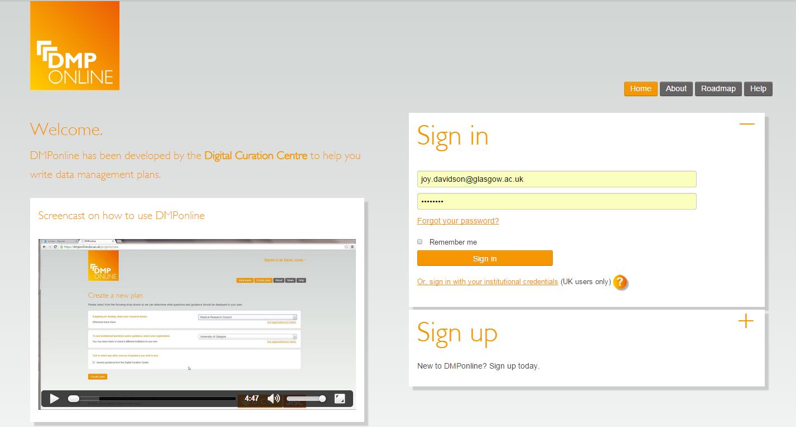
DCC provides access to tools
https://dmponline.dcc.ac.uk
Notes:
Web-based tool to help researchers write Data Management and Sharing Plans according to different funder / institutional requirements
There are various templates in DMP Online based on different funder requirements and institutional customisations.
We’re currently enhancing it with practical examples, boilerplate text and tailored support. TEDDINET may wish to develop discipline specific guidance within the tool for future related projects.
9

Slide 10
Skills development in RDM for researchers and service providers
Notes:
For the next few slides, I’ll consider some of the ideals we’d like to see in data management planning.

Slide 11
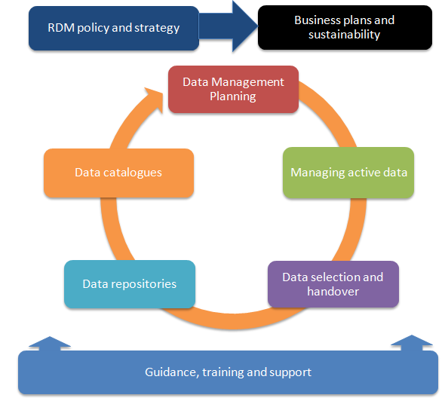
RDM service model
http://www.dcc.ac.uk/resources/developing-rdm-services

Slide 12
What is the national picture in the UK?
Policy and strategy – 87%
Business planning – 13%
Data Management Planning – 50%
Data cataloguing – 38%
Managing active data – 40 %
Data preservation – 18%
Governing access & reuse – 22%
Skills training & consultancy – 63%
% indicating ‘rolling out’ or ‘embedding’
Notes:
The 2015 DCC survey collected responses from 60 institutions mapped to the DCC RDM services model.
You’ll notice that training underpins the more technical infrastructure requirements in the centre which as based around the data lifecycle.
Majority of UK HEIs making good progress in developing training and guidance. Longer term preservation and business case development are proving more difficult across UK HEIs. These will have an impact on training provision as well.

Slide 13
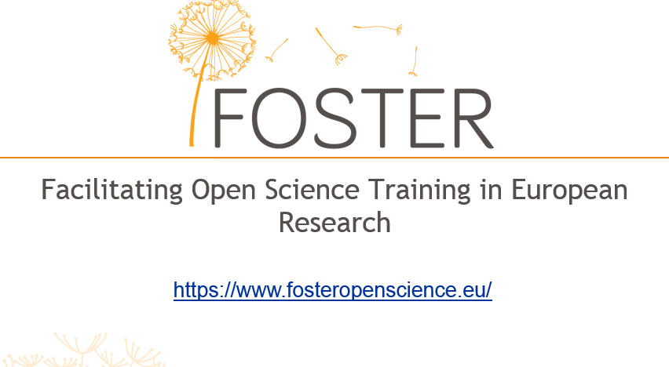
Assessing the EU training landscape
Notes:
DCC has been around for 11 years. Training has always been a core activity. More recently, as a core partner in this FP7 project.
Through DCC core activity and our project work with FOSTER and 4C, we ran approximately 60 training in 2014-15 events and trained about 3500 participants (UK, EU, US, Africa)
Jisc RDM Readiness workshop - February 13 2015
Workshop considered challenges in meeting the EPSRC policy framework and included aa breakout on training approaches

Slide 14
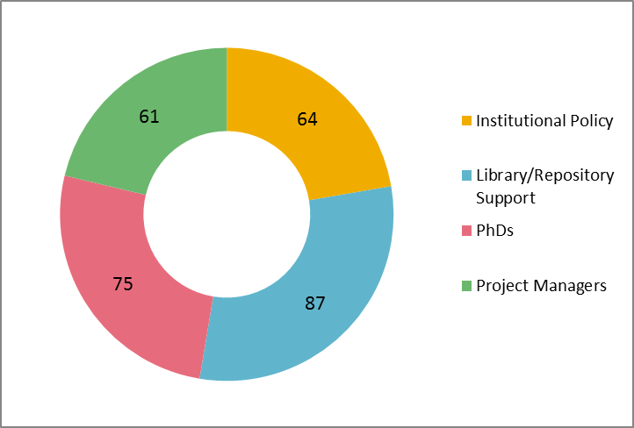
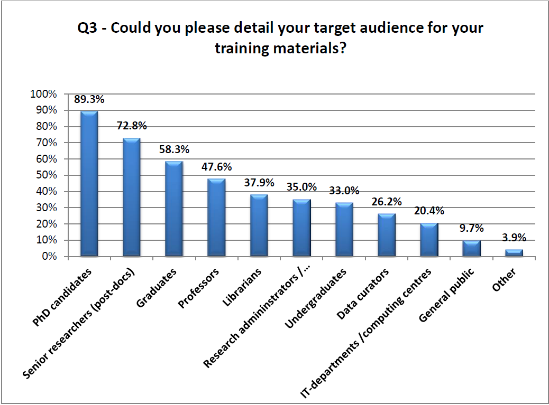
Who are we training?
Library staff
Research administrators
IT staff
Project officers (e.g., European Commission)
Resources by Audience
FOSTER landscape analysis
KE workshop Survey results
Notes:
There is a lot of train the trainer activity under way to target:
Librarians, research administrators and IT targeted but majority of training targeted towards researchers.
As part of our FOSTER activity, we carried out a landscape study of existing training materials and activity.
There was a very good split of resources identified across our four key target groups. We identified a slightly higher number of resources targeted to Libraries/Repository Support staff which is beneficial as in most cases it is this group that will be responsible for providing training to staff and students within European HEIs. Interestingly, most of the resources identified were applicable to more than one target audience which means that with slight revisions, the materials should be widely applicable for reuse.

Slide 15
A lot of service groups being targeted… but who is missing?
Archivists and records management team
Finance team
Legal office
DP/FoI
Ethics team
Discipline specific support (departmental or school level).
Notes:
Archivists and records managers - especially with regards to selection, appraisal and retention
Finance staff - costing RDM
Legal team - copyright and licensing
Ethics teams - there is a risk of disjoin between openness and data protection. Ethics panel members will need to have sufficient awareness of funders’ data sharing requirements and the potential benefits and impact for researchers.

Slide 16
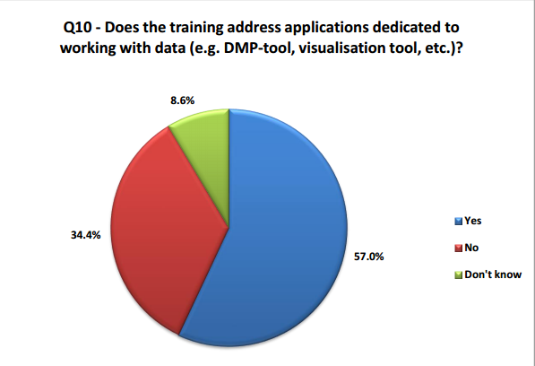
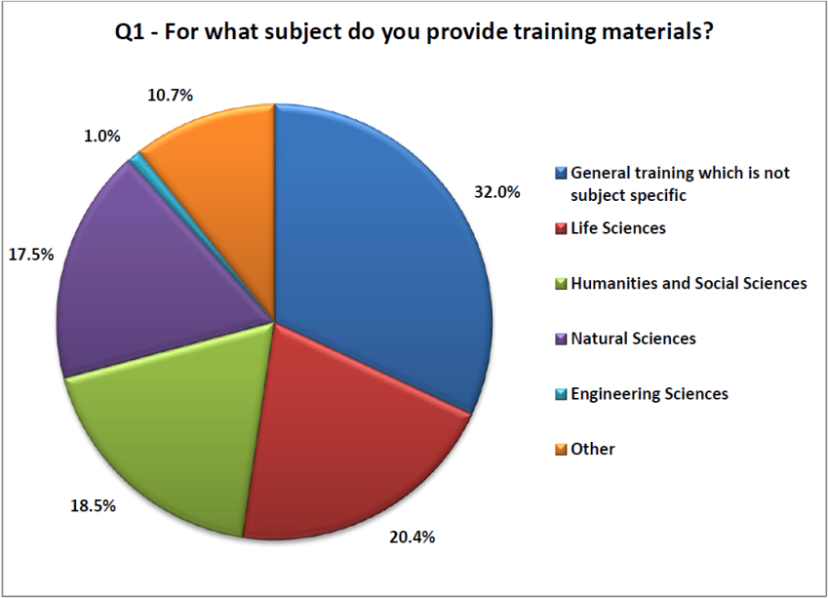
What are the topics being covered in training and at what level?
Entire lifecycle
Specific use of RDM tools (e.g., DMPonline)
Generic vs discipline specific
KE workshop Survey results
Notes:
There is a lot of train the trainer activity under way to target library staff, research office staff, IT staff and increasingly project officers from funding bodies.

Slide 17
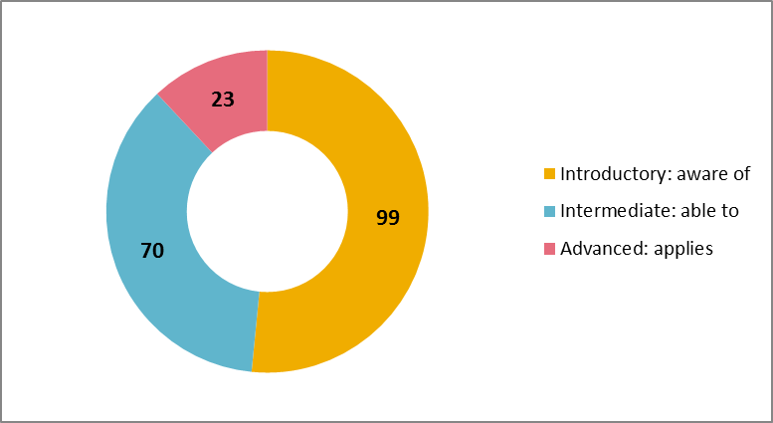
Gaps in coverage
Dealing with non-digital data
Training on costing RDM
Intermediate and advanced level training
Resources by Level of Knowledge
FOSTER landscape analysis
Notes:
Making sure that all data is adequately managed and linked – not just digital (e.g., core or tissue samples)
Costs – bear in mind curation cost coverage varies from council to council
Ensuring that trainers can progressively build up their expertise over time
Introductory level materials provide an awareness of key issues.
Intermediate level materials ensure that participants are able to do something particular after completing the course.
Advanced level materials ensure that those completing the course can apply their knowledge in their own particular setting.
The majority of the training resources identified by the FOSTER team fell with within the introductory or intermediate categories. We may seek to increase the level of advanced materials in years to come as the cohort of trainers become more skilled in dealing with RDM issues.

Slide 18
How big are institutional RDM teams?
Most HEIs have less than two dedicated staff members in data management posts
Posts spread across the institution (Library, IT, Research Office).
Notes:
Based on RDM Readiness workshop breakout group on skills and training, we should bear in mind a few practical points.
Small teams are the norm. Makes it difficult to carry out day to day support and design and deliver training.
We need to be aware of these constraints and ensure that others across the institution are also involved in delivering training and not just those tasked with RDM duties. However, spread across HEI can make this time consuming and difficult.

Slide 19
Short term opportunities to explore
Reduce burden by blending general training from external providers (DCC, UK Data Service, FOSTER) with locale-specific information
Explore partnerships with European Research Infrastructures (e.g., ERICS) in developing discipline specific and infrastructure specific training
Buddying those just getting started with more mature institutions
Notes:
(local infrastructure, policies and support)
Buddying idea proposed by DCC colleague Laura Molloy (2015)

Slide 20
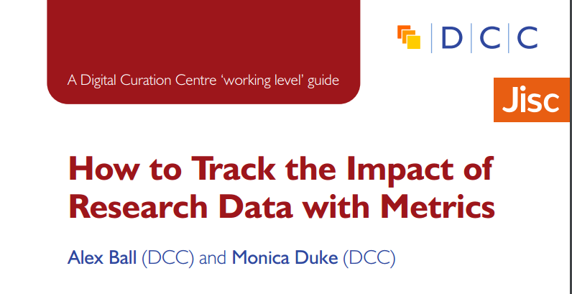
Longer term: define how to measure success
http://www.dcc.ac.uk/resources/how-guides/track-data-impact-metrics
How can we assess impact our training?
Notes:
There has been quite a bit of thinking around measuring the impact of research data.
However, as RDM infrastructure is defined and rolled out across the sector, we’ll need to consider collectively how we assess the performance of RDM services like training - both for trainers themselves and those they go on to train.

Slide 21
Benefits in
Compliance with external funding bodies mandates but also…
Systems and support that are utilised and relevant to researchers’ needs
Better and more reproducible research
More visible research outputs and increased impact
Easier reporting through more joined up systems and processes

Slide 22
Relationship between RDM and research information
management systems and workflows
Notes:
For the next few slides, I’ll consider some of the ideals we’d like to see in data management planning.

Slide 23
Developing a data management plan (DMP)
What data will be created (format, types, volume...)
Standards and methodologies to be used (incl. metadata)
How ethics and Intellectual Property will be addressed
Plans for data sharing and access
Strategy for long-term preservation
Create
Preserve
Document
A DMP is a plan to share!
Share
Use
Store
Notes:
First of all, what is a Data Management Plan (dmp)?
Essentially, most funders just want evidence at the grant stage that data has been considered – how much will be generated? Usually just a 1-2 page summary covering the expected data to be produced through research along with an idea of what might be shared and how and when it will be shared.
It is important to stress that funders aren’t expecting something carved in stone at this stage. Projects often change quite radically from what is submitted at the proposal stage and this is ok. Researchers just need to be able to provide evidence that they have thought about the data they might be generating and how it will be managed and shared.
In terms of preservation, it is important to remember that not ALL data has to be retained. Selecting what data needs to be kept is something that only the researcher can do. Essentially, he/she will need to retain any data that underpins published findings to allow for validation of results. Additional data that is not required for validation purposes but is deemed to have longer-term value might also be worth keeping.
DMPs are often submitted as part of grant applications, but are useful whenever you’re creating data. Some HEIs are introducing policies that require DMPs for all research undertaken by staff – whether externally funded or not.

Slide 24
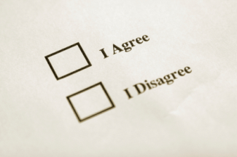
Ethics approval process: Who decides what data can be shared?
PI/researcher
Data repository and support staff
Research participants
Commercial partners
Secondary data user
Notes:
While the researchers themselves will have a key role to play in sharing data, it is important to note that they are not the only stakeholders involved in the process.
Repository – how will data be made visible?
Support staff – e.g., Library staff to help describe data to make it easier to find and understand.
Research participants – informed consent is required. Anonymisation can be very costly.
Commercial – identify what can and can’t be shared and make this explicit. Develop consortium agreements that make each partners rights explicit.
Secondary user – when sharing data, researchers can ask reusers to tick that they accept terms and conditions regarding fair use
24

Slide 25
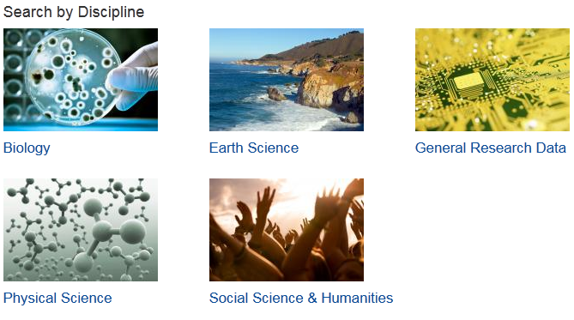
Research outputs: describing research data
http://www.dcc.ac.uk/resources/metadata-standards
Notes:
Use an existing standard whenever possible (almost always!) DCC Metadata catalogue, explaining what they are, who's using them and how to use them. Ideally, use of standard unique IDs (grant, ORCIDs, funders, institution, DOIs). Metadata should capture provenance info. WC3 PROV-O standard and Australian National Data Services (ANDS) work might be relevant. Ideally, we'd be able to reuse info from other institutional systems like CRIS to reduce burden. Things like abstracts from proposals can be quite useful as lay summaries. Ideally, all funders would sponsor discipline specific data centres (e.g. UK Data Service) where data could be deposited and curated. But, it is equally important to stress that we need good RDM across the entire lifecycle not just at the point of deposit at the end of the project. All activities across the lifecycle have an impact on the quality and potential reuse value of research data so infrastructure at the institutional level is crucial.
Instead of all effort being taken on by one stakeholder (funder or institution), it may be best to explore hybrid solutions where data is managed and stored locally but a virtual curation layer is supported across stakeholders. In this approach, discpline specific support for quality assurance, selection and appraisal, and description could be handled in a virtual curation layer built on top of local RDM and longer term storage infrastructure.
25

Slide 26
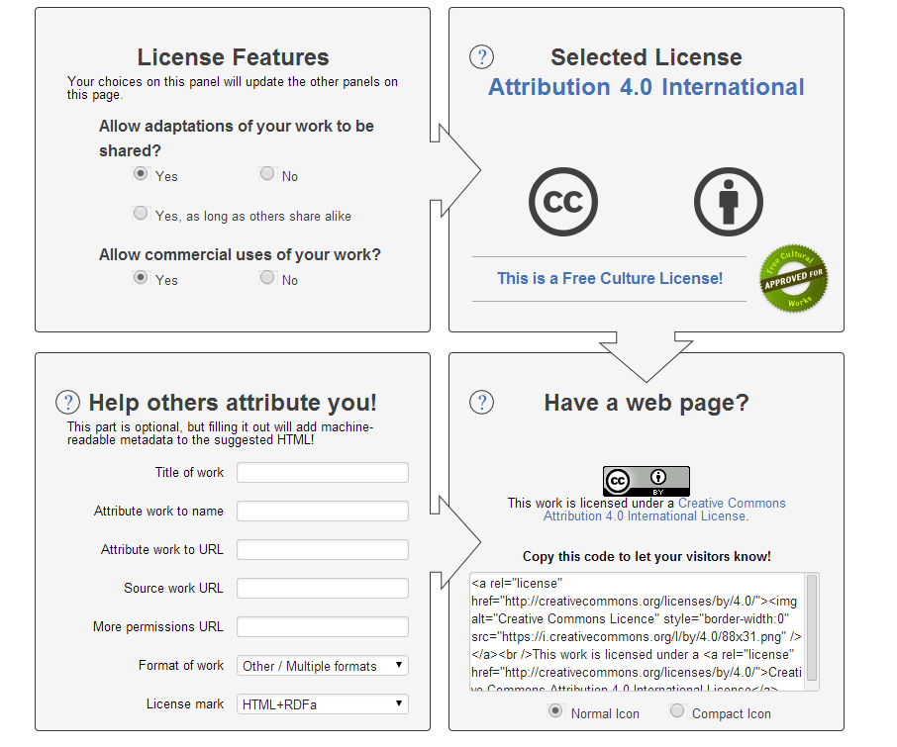
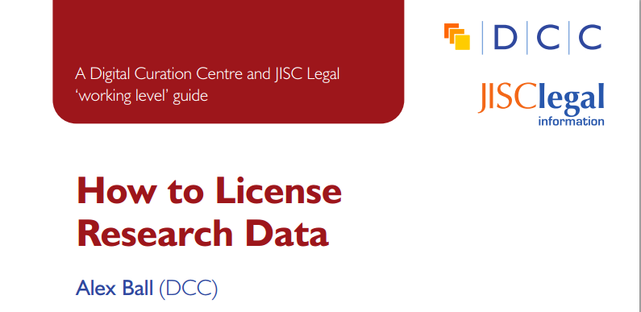
What do you want others to be able to do with your data?
www.dcc.ac.uk/resources/how-guides/license-research-data
http://creativecommons.org/choose/
Notes:
Ideally, we’d like to see researchers embrace Open Science and make as much of their data available with as few restrictions as possible. However, where that isn’t possible, it is important to be clear on why data can’t be shared.
For data that can be published, ensure potential reusers are clear about what can and can‘t be done with data by applying a relevant license. Provide a recommended data citation for data set. UK Data Service provides information on tools that are helpful for citing specfic sections of interviews and other types of social science data that might be collected. Researchers should be able to exploit commercial potential by selecting the right license (e.g., not closing any doors). Researchers should be aware of any restrictions on using third party data in their research and be clear on what they can share while respecting licenses on others' data.

Slide 27
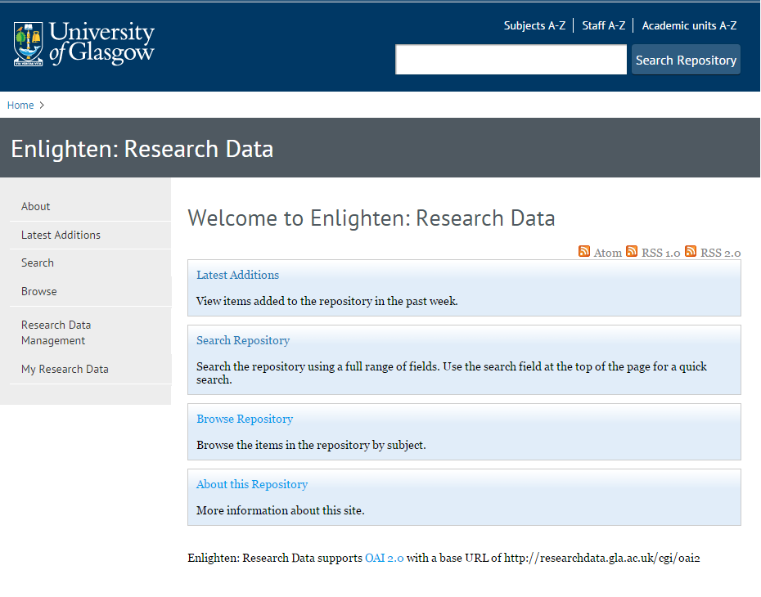
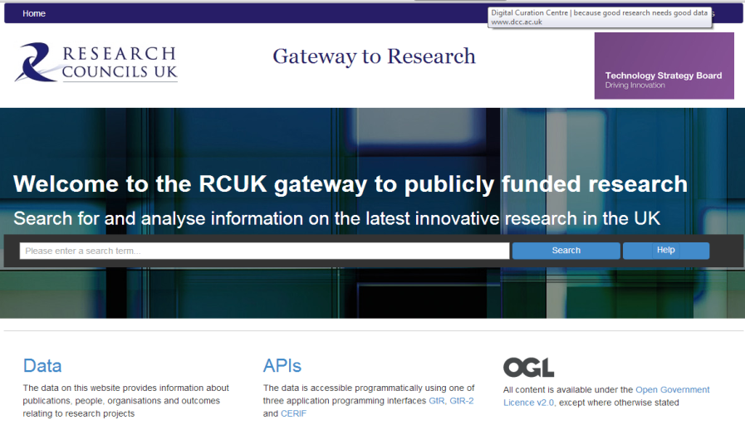
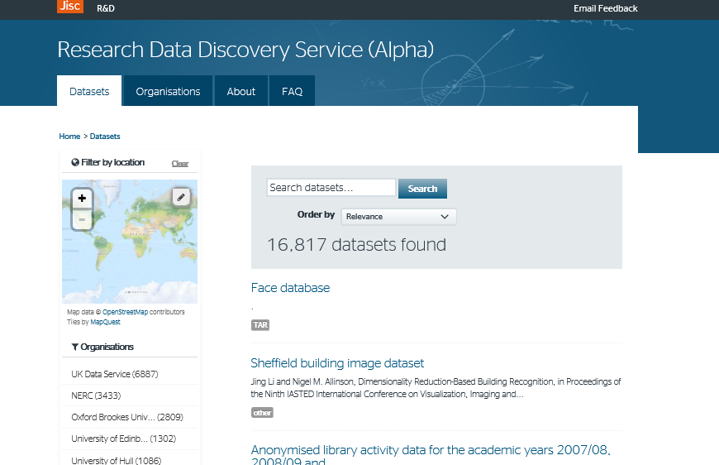
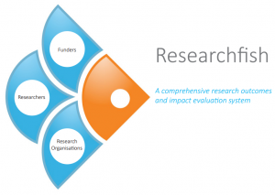
How will you make your data discoverable?
http://gtr.rcuk.ac.uk/
http://researchdata.gla.ac.uk/
https://www.researchfish.com/
http://ckan.data.alpha.jisc.ac.uk/dataset
Notes:
A myriad of discovery mechanisms. Institutional data catalogues, natonal discovery services and funder registries. It would be ideal if data was entered once and shared between these systems more effectively.
27

Slide 28
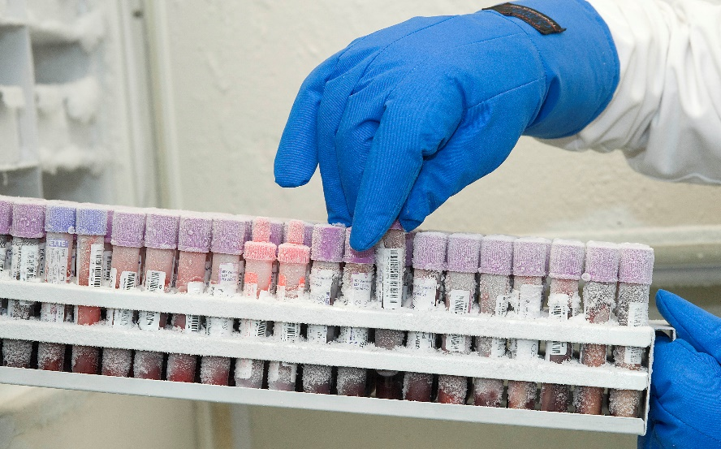
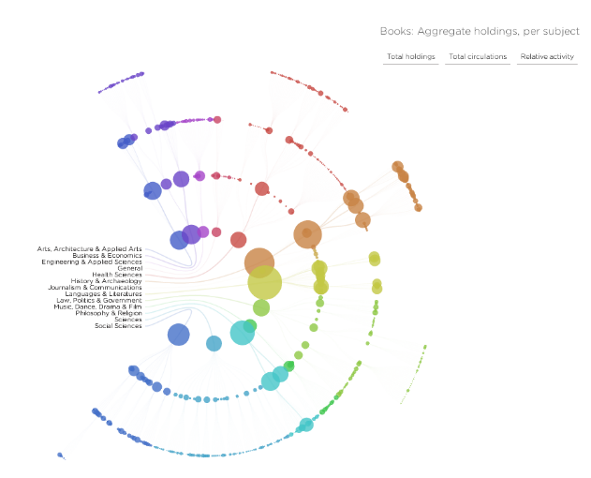
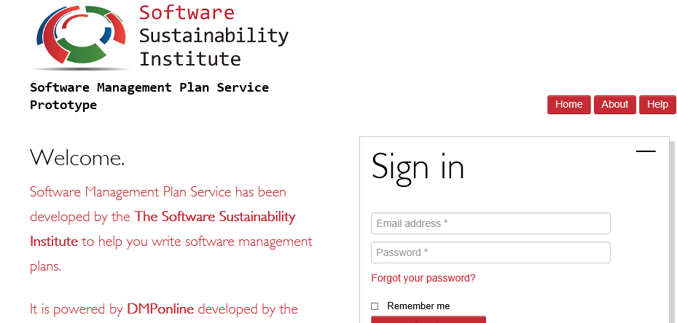
What about physical data, software and models?
http://www.ukcrcexpmed.org.uk/Coventry_Warwick_CRF/PublishingImages/Tissue%20Bank%201.jpg
http://spatialinformationdesignlab.org/project_sites/library/catalog.html
https://ssi-dev.epcc.ed.ac.uk/
Notes:
Remember that not all research data is digital. Consider how you will maintain links between research outputs and analogue data like tissue samples. How will access to these resources be provided if needed?
In some cases, algorithms and models are more valuable than the data being run through them so be clear on what it is you need to keep (e.g., genomic data and models).

Slide 29
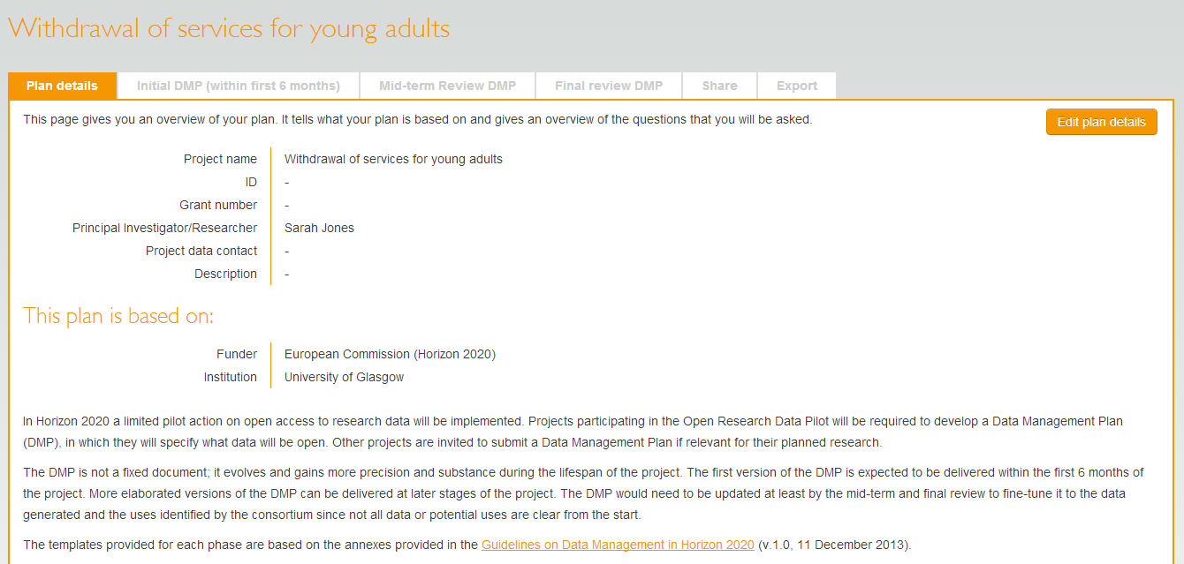
Plans created within DMPonline tool can be updated to reflect research lifecycle…
Phases
… but most do not update the DMP throughout the life of the project.
Notes:
Consider reviewing the plan at lease as often as you provide updates to your funder. Consider making your final phase DMP public via your institutional repository and link it to you publication and data set.
Consider publishing the final version DMP as a data paper – increasing number of peer reviewed data journals emerging. Good to get credit for your efforts!
29

Slide 30
Good practice when creating DMPs
Start early!
Justify additional resource needed for RDM and add to proposed budget
Do not to write the plan in isolation – seek advice from colleagues (ethics, IT, library)
Be realistic - base plans on available skills & support. Don't gold plate plan.
The plan will - and should - change over time!

Slide 31
Lack of RDM infrastructure metrics: how to measure success
http://www.dcc.ac.uk/resources/how-guides/track-data-impact-metrics
Notes:
There has been quite a bit of thinking around measuring the impact of research data.
However, as RDM infrastructure is defined and rolled out across the sector, we’ll need to consider collectively how we assess the performance of RDM services like training - both for trainers themselves and those they go on to train.
31

Slide 32

Good RDM helps you comply with mandates but also leads to…
Systems and support that are utilised and relevant to researchers’ needs
More visible research outputs and increased impact - even for negative results
Easier reporting through more joined up systems and processes
Better and more reproducible research!

Slide 33

Thanks for listening!
joy.davidson@glasgow.ac.uk
www.dcc.ac.uk
Follow us on twitter:
@jd162a
@digitalcuration and #ukdcc

